Slide 1
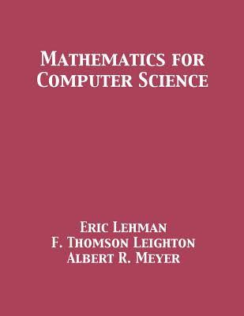
Chapter 9
Number Theory
数论

Slide 2
本章内容概览
一些基本的性质
9.1
整除性 / divisibility
著名的Euclid算法
9.2
最大公约数/Greatest common divisor
9.3
算术基本定理/The fundamental theorem of arithmetic
9.4
模算术/Remainder arithmetic
9.5
Euler定理/Euler‘s Theorem
9.6
RSA加密系统/The RSA Cryptosystem

Slide 3
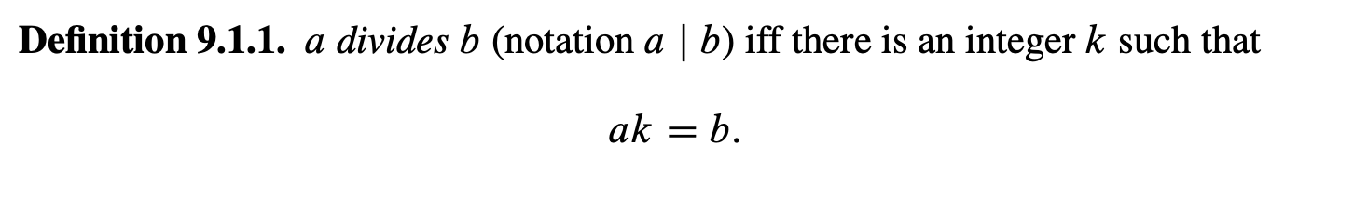
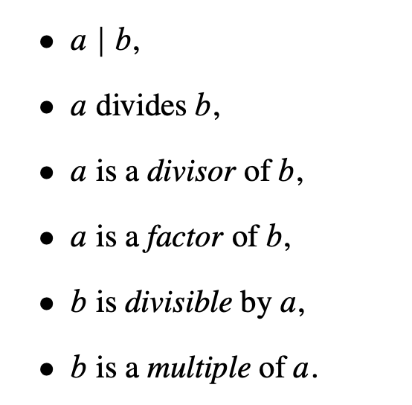
整除
1. 整除关系
因子提取机
(一些等价定义)

Slide 4
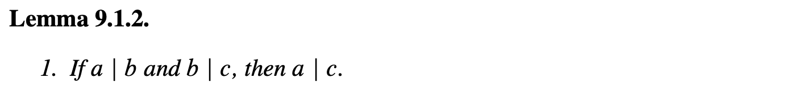
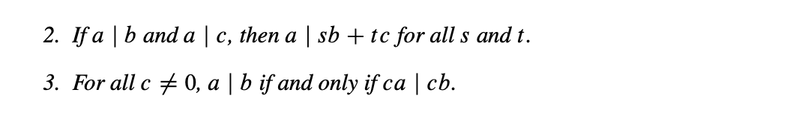
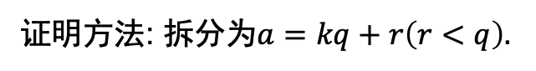
整除
Word
divide 除法
notation 记号
1. 整除关系
2. 整除的一些性质
很像线性组合
证明方法: 拆分为$a=kq+r\left(r<q\right).$

Slide 5
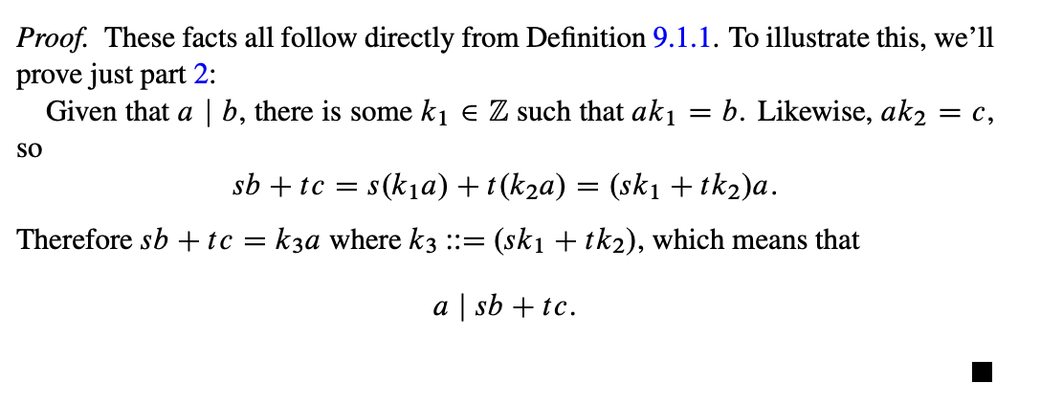
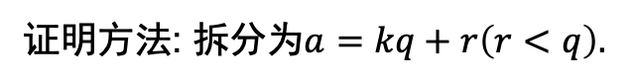
整除
2. 整除的一些性质
很像线性组合
证明方法: 拆分为$a=kq+r\left(r<q\right).$

Slide 6
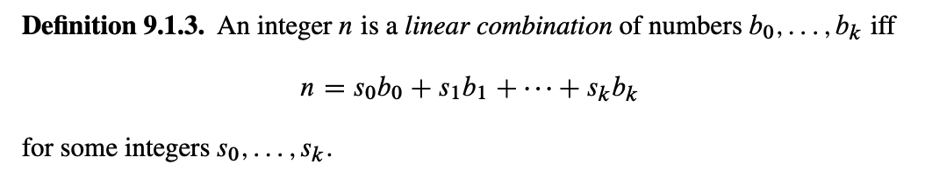
整除
Word
linear 线性
combination 组合
2. 整除的一些性质
很像线性组合
证明方法: 拆分为$a=kq+r\left(r<q\right).$

Slide 7
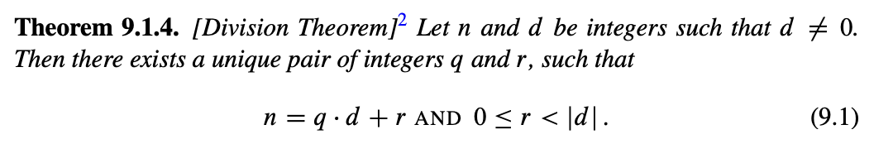
整除
Word
integer 整数
商 quotient
余数 remainder
3. 整除定理
这个很像我们小学学的东西
商 - quotient
余数 - remainder

Slide 8
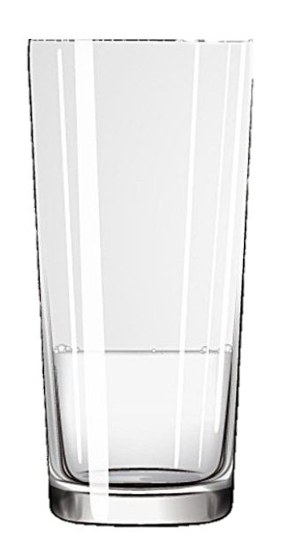
整除
Thr Die-hard problem
3L
5L

Slide 9
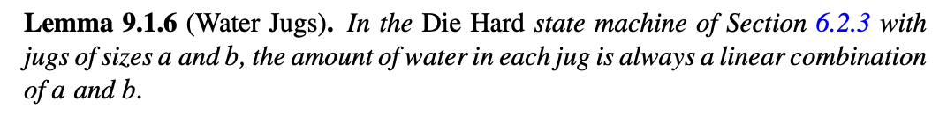
整除
Word
jug 杯子
一个游戏: Water-jug problem
water-jug.py
合法操作:
把一个水杯装满
把一个水杯倒入另一个
最后:
得到某个数字的升数
3L
5L
可以使用归纳法证明.

Slide 10
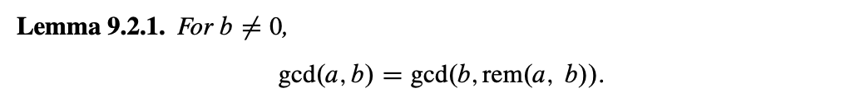
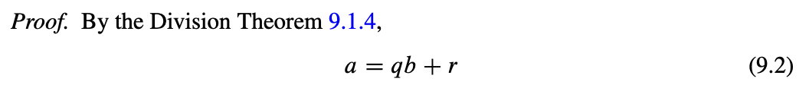
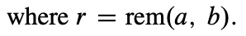
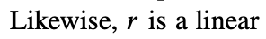
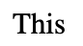
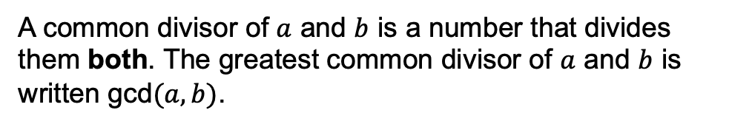
最大公约数
1. 最大公约数
A common divisor of $a$ and $b$ is a number that divides them both. The greatest common divisor of $a$ and $b$ is written gcd$(a, b)$.
2. 求解的方法之一: Euclid的算法

Slide 11
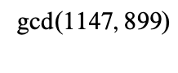
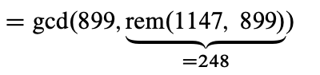
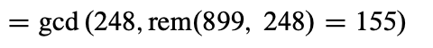
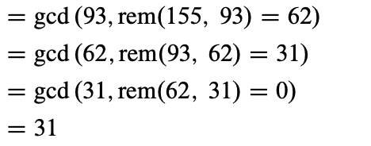
最大公约数
2. 求解的方法之一: Euclid的算法
举个例子

Slide 12
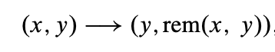
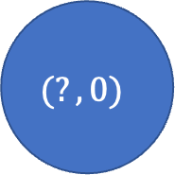
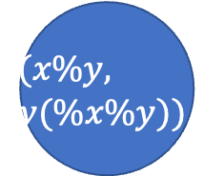
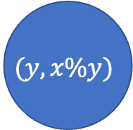
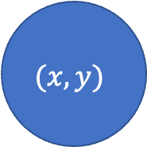
最大公约数
2. 求解的方法之一: Euclid的算法
这个问题的状态机模型是什么?
$$(x,y)$$
$$(y,x\%y)$$
$$(x\%y,$$
$$y(\%x\%y))$$
$$(?,0)$$
…

Slide 13
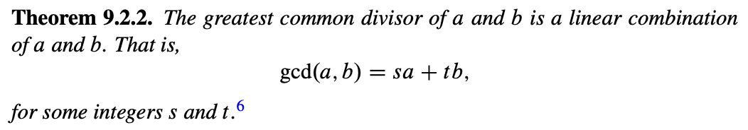
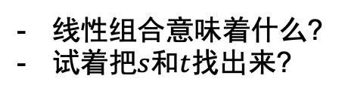
最大公约数
3. 求一个不定方程的整数解: 一个副产物
线性组合意味着什么?
试着把$s$和$t$找出来?

Slide 14
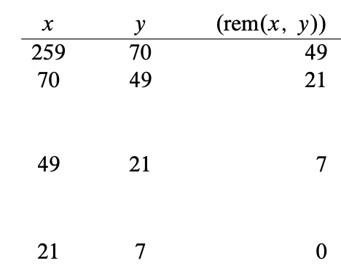
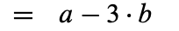
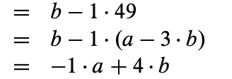
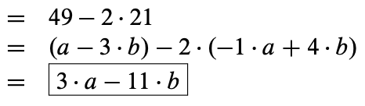
最大公约数
3. 求一个不定方程的整数解: 一个副产物

Slide 15
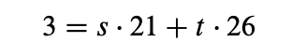
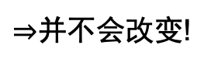
最大公约数
4. 求一个不定方程的整数所有解: 回到Water jug的问题
刚刚的问题中并不能保证所有的值都是正的, 这下怎么办?
有没有那些其他的数也是满足的呢?
观察:
$⇒$并不会改变!
这样我们就可以找到一个合适的s和t了.
那我们一直这样pour下去…
我们找到了一个通解.

Slide 16
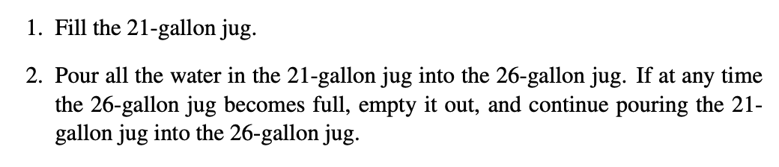
最大公约数
4. 求一个不定方程的整数所有解: 回到Water jug的问题
一个有趣的策略:

Slide 17
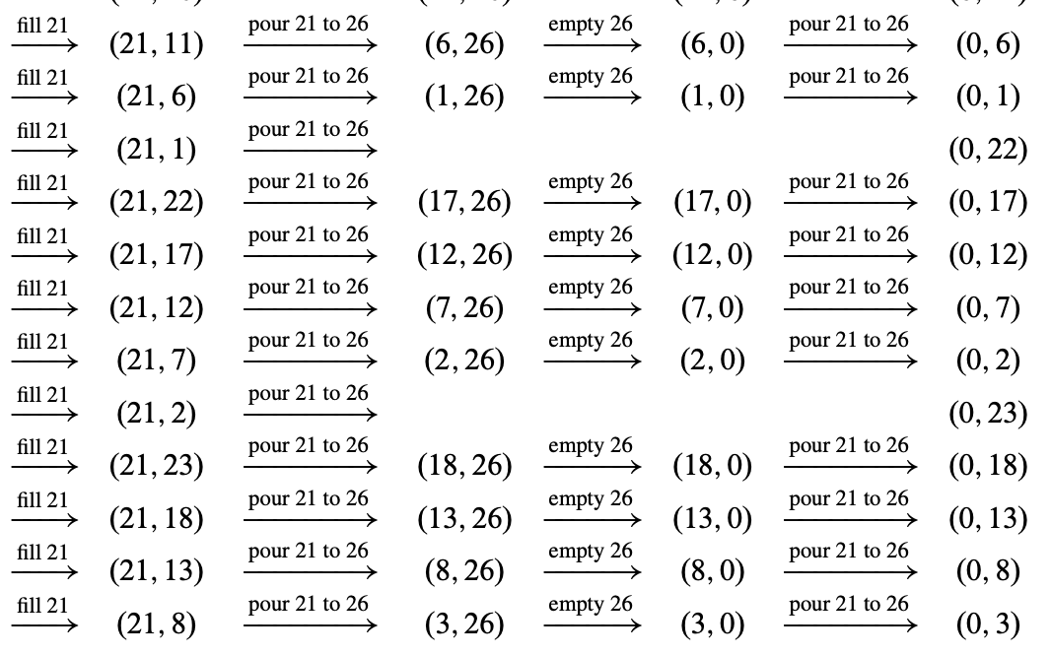
最大公约数

Slide 18
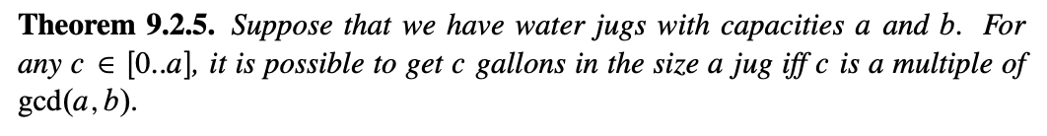
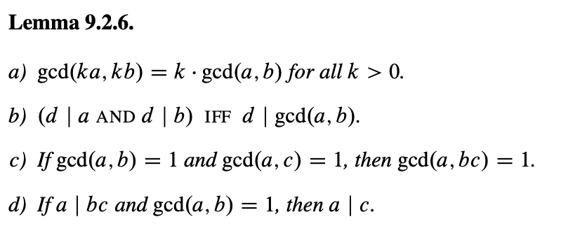
最大公约数
4. 求一个不定方程的整数所有解: 回到Water jug的问题
5. 最大公约数的一些性质

Slide 19
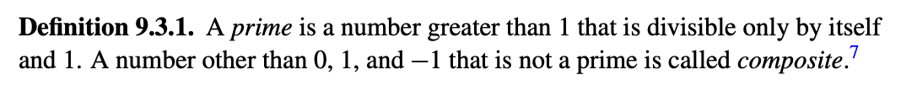
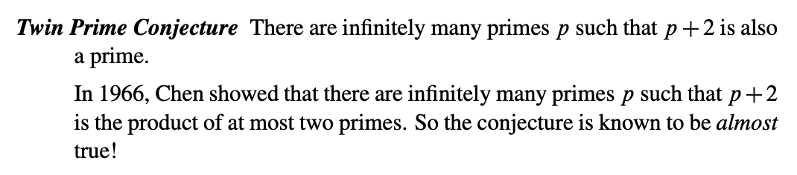
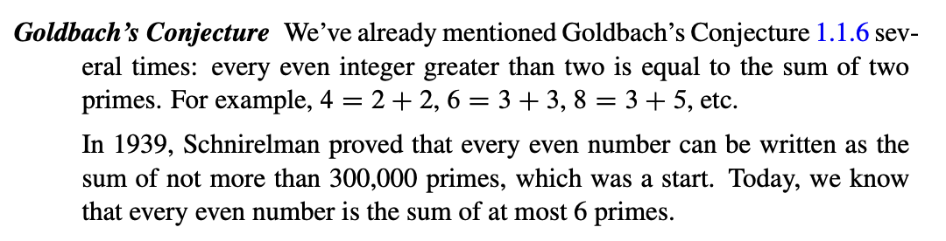
质数与关于质数的谜团
Word
prime 质数
composite 合数
conjecture 猜想
1. 质数
2. 一些有关质数有名的猜想

Slide 20
本章内容概览
一些基本的性质
9.1
整除性 / divisibility
著名的Euclid算法
9.2
最大公约数/Greatest common divisor
9.3
算术基本定理/The fundamental theorem of arithmetic
9.4
模算术/Remainder arithmetic
9.5
Euler定理/Euler‘s Theorem
9.6
RSA加密系统/The RSA Cryptosystem

Slide 21
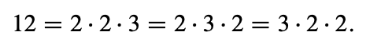
算术基本定理
Word
arithmetic 代数的
如果不计次序, 那么这个是唯一的..?
1. 代数基本定理
2. 如何证明?
你不能用唯一分解定理整这个! 我们可以用它导出唯一分解定理.

Slide 22
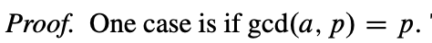
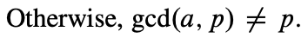
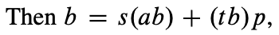
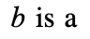
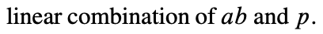
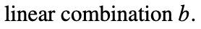
算术基本定理
2. 如何证明?
Since 1 and p are the only positive divisors of p
of p
Word
claim 声称
multiple 倍数
otherwise 否则
multiply by b on both sides
我们可以推广到更一般的情况.

Slide 23
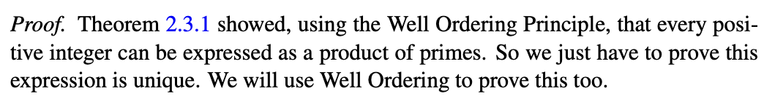

算术基本定理
2. 如何证明?

Slide 24




算术基本定理
2. 如何证明?

Slide 25

算术基本定理
啥啥啥, 这都是啥?
不用太纠结, 习惯就好
回顾《马克思主义原理》: 认知的过程

Slide 26


关于Alan Turing的故事
我们来做一个英语阅读! 但是很好玩!
The man pictured in Figure 9.1 is Alan Turing, the most important figure in the history of computer science. For decades, his fascinating life story was shrouded by government secrecy(secret), societal taboo, and even his own deceptions(cheating).

Slide 27
关于Alan Turing的故事
我们来做一个英语阅读! 但是很好玩!
At age 24, Turing wrote a paper entitled On Computable Numbers, with an Application to the Entscheidungsproblem. The crux(key) of the paper was an elegant way to model a computer in mathematical terms. This was a breakthrough, because it allowed the tools of mathematics to be brought to bear(implement, work) on questions of computation. For example, with his model in hand, Turing immediately proved that there exist problems that no computer can solve—no matter how ingenious(talented) the programmer.

Slide 28


关于Alan Turing的故事
我们来做一个英语阅读! 但是很好玩!
Turing’s paper is all the more remarkable because he wrote it in 1936, a full decade(ten years) before any electronic computer actually existed.
The word “Entscheidungsproblem” in the title refers to one of the 28 mathematical problems posed by David Hilbert in 1900 as challenges to mathematicians of the 20th century. Turing knocked that one off in the same paper. And perhaps you’ve heard of the “Church-Turing thesis”? Same paper. So Turing was a brilliant guy who generated lots of amazing ideas. But this lecture is about one of Turing’s less-amazing ideas. It involved codes. It involved number theory. And it was sort of stupid.
David Hilbert

Slide 29
关于Alan Turing的故事
我们来做一个英语阅读! 但是很好玩!
Let’s look back to the fall of 1937. Nazi Germany was rearming under Adolf Hitler, world-shattering war looked imminent(about to happen), and—like us — Alan Turing was pondering the usefulness of number theory. He foresaw(predict) that preserving military secrets would be vital in the coming conflict and proposed a way to encrypt communications using number theory.
在那个年代, 就已经可以希望加密通话了…
David Hilbert

Slide 30

关于Alan Turing的故事
我们来做一个英语阅读! 但是很好玩!
This is an idea that has ricocheted(cause to rebound off the surface) up to our own time. Today, number theory is the basis for numerous(huge) public-key cryptosystems(systems that encrypts), digital signature schemes, cryptographic hash functions, and electronic payment systems. Furthermore, military funding agencies are among the biggest investors in cryptographic research. Sorry, Hardy!
Hardy曾经说过:数论好玩, 但是没用之类的话.
Hardy

Slide 31
关于Alan Turing的故事
我们来做一个英语阅读! 但是很好玩!
Soon after devising(plan or invent in a carful thought) his code, Turing disappeared from public view, and half a century would pass before the world learned the full story of where he’d gone and what he did there. We’ll come back to Turing’s life in a little while; for now, let’s investigate the code Turing left behind. The details are uncertain, since he never formally published the idea, so we’ll consider a couple of possibilities.

Slide 32





Turing的密码(1)
text
integer
便于我们在上面做操作
13
requires message to be a prime number
But how do we encrypt this?
Some notations.

Slide 33



Turing的密码(1)
f(“jyyyyds”)=998244353
But how do we encrypt this?
我们约定$k=19260817$
Some notations.
zgw
19227001804416401
xbz
好
19227001804416401/19260817
=998244353=f(“jyyyyds”)

Slide 34
Turing的密码(1)
f(“jyyyyds”)=998244353
我们约定$k=19260817$
Q1. 你咋知道这俩数是质数? – 素性测试, 会排除大部分
Q2. 这玩意安全吗?
zgw
19227001804416401
看上去挺安全, 因为它很难被找到因子啊!
xbz
好
19227001804416401/19260817
=998244353=f(“jyyyyds”)

Slide 35


Turing的密码(1)
Q1. 你咋知道这俩数是质数? – 素性测试, 会排除大部分
Q2. 这玩意安全吗?
看上去挺安全, 因为它很难被找到因子啊!
f(“jyyyyds”)=998244353
f(“zfhyds”)=10000000007
我们约定$k=19260817$
同样的约定$k=19260817$
zgw
19227001804416401
对比这俩
zgw
192608170134825719
好
好
xbz
xbz
19227001804416401/19260817
=998244353=f(“jyyyyds”)
192608170134825719/19260817
=10000000007=f(“zfhyyds”)
如果两条消息被截获了呢?(同一个key)

Slide 36

Turing的密码(1)
We have that
怎么办? 我们需要模运算帮助我们…

Slide 37
本章内容概览
一些基本的性质
9.1
整除性 / divisibility
著名的Euclid算法
9.2
最大公约数/Greatest common divisor
9.3
算术基本定理/The fundamental theorem of arithmetic
9.4
模算术/Modular arithmetic
9.5
Euler定理/Euler‘s Theorem
9.6
RSA加密系统/The RSA Cryptosystem

Slide 38



具有相同的余数与模
Word
congruence 同余
1. 同余的记号
Written as
2. 同余: 余数相同
证明概要: 假设不同, 最后推出相同.

Slide 39

具有相同的余数与模
Word
congruence 同余
3. 同余满足的关系
这是一个等价关系.
Z
Z={1,2,3,4,5,6,7,8,…}
模3余0
模3余1
模3余2
划分
不重复, 不遗漏, 没有集合是空集

Slide 40


具有相同的余数与模
Word
congruence 同余
3. 同余满足的关系
Z上运算
简化
$$Z_{3}上的运算$$
取划分之后的集合的代表元作用一下, 其代表的情况和原来一致吗?
congruence relations are preserved by addition or multiplication?

Slide 41

具有相同的余数与模
Word
congruence 同余
3. 同余满足的关系
Yes!
这样我们就可以构造更多的运算了!

Slide 42




具有相同的余数与模
比如要求这个的余数:
其实就可以化为
$$⇒$$
类似地

Slide 43

具有相同的余数与模

Slide 44



环$ℤ[n]$
问题: 这一切为什么会工作? 有没有其他结构同样也工作?
先引入记号

Slide 45


环$ℤ[n]$
问题: 这一切为什么会工作? 有没有其他结构同样也工作?

Slide 46

关于Alan Turing的故事(2)
我们来做一个英语阅读! 但是很好玩!
In 1940, France had fallen before Hitler’s army, and Britain stood alone against the Nazis in western Europe. British resistance depended on a steady flow of supplies brought across the north Atlantic from the United States by convoys(teams) of ships. These convoys were engaged in a cat-and-mouse game with German “U-boats” —submarines(boats travel underwater)—which prowled(move to seek pray) the Atlantic, trying to sink supply ships and starve Britain into submission. The outcome of this struggle pivoted(based) on a balance of information: could the Germans locate convoys better than the Allies could locate U-boats, or vice versa?

Slide 47
关于Alan Turing的故事(2)
我们来做一个英语阅读! 但是很好玩!
Germany lost.
A critical reason behind Germany’s loss was not made public until 1974: Germany’s naval(secret) code, Enigma, had been broken by the Polish Cipher Bureau, and the secret had been turned over to the British a few weeks before the Nazi invasion of Poland in 1939.
Throughout much of the war, the Allies were able to route convoys around German submarines by listening in to German communications. The British government didn’t explain how Enigma was broken until 1996.

Slide 48
关于Alan Turing的故事(2)
我们来做一个英语阅读! 但是很好玩!
When the story was finally released (by the US), it revealed that Alan Turing had joined the secret British codebreaking effort at Bletchley Park in 1939, where he became the lead developer of methods for rapid, bulk(massive, huge) decryption of German Enigma messages.
Turing’s Enigma deciphering(convert sth. into normal language) was an invaluable contribution to the Allied victory over Hitler.

Slide 49
关于Alan Turing的故事(2)
我们来做一个英语阅读! 但是很好玩!
Governments are always tight-lipped about cryptography, but the half-century of official silence about Turing’s role in breaking Enigma and saving Britain may be related to some disturbing events after the war—more on that later.
Let’s get back to number theory and consider an alternative(another) interpretation(explanation) of Turing’s code. Perhaps we had the basic idea right (multiply the message by the key), but erred(having mistakes) in using conventional arithmetic instead of modular arithmetic. Maybe this is what Turing meant:

Slide 50


Turing的密码(2)
和上一次一样, 我们有
Announcement
我们约定private key$=998244353$
通信的public key是:
19260817
zgw
xbz
好

Slide 51


Turing的密码(2)
和上一次一样, 我们有
这时候我们应该如何解? 总不能除出来是分数吧…

Slide 52










模意义下的 “除法”
在平常的代数里面, 我们有
$$ab=bc(b≠0)$$
1. 乘法的逆元
在$Z[n]$的情况下表现如何?
1

Slide 53

模意义下的 “除法”
1. 乘法的逆元
什么时候可以有? 什么时候没有?
但是也不总是存在

Slide 54



模意义下的 “除法”
Word
2. 互素
coprime 互素
Def. Relative Primarily
So we have the equation that
上一节的ax+by=gcd(a,b)保证的
that is
使用模算术的一些结论

Slide 55




模意义下的 “除法”
Word
2. 互素
coprime 互素
inverse 逆元
那么, 这逆元是唯一的吗?
3. 模意义下的约分
\
\
$$⇒10=5$$
(x)
ℝ里面的乘法 “约分” – 除以它 – 乘上它的逆元

Slide 56


模意义下的 “除法”
3. 模意义下的约分
\
\
$$⇒10=5$$
(x)
ℝ里面的乘法 “约分” – 除以它 – 乘上它的逆元
3 is not relative prime to 15, hence it can not be cancellable

Slide 57
Turing的密码(2)
乘完之后找到逆元做一下就好了!

Slide 58
破解Turing的密码(2)
The Germans didn’t bother to encrypt their weather reports with the highly-secure Enigma system. After all, so what if the Allies learned that there was rain off the south coast of Iceland? But amazingly, this practice provided the British with a critical edge in the Atlantic naval battle during 1941.
The problem was that some of those weather reports had originally been transmitted using Enigma from U-boats out in the Atlantic. Thus, the British obtained both unencrypted reports and the same reports encrypted with Enigma. By comparing the two, the British were able to determine which key the Germans were using that day and could read all other Enigma-encoded traffic. Today, this would be called a known-plaintext attack.
encrypted
original

Slide 59



破解Turing的密码(2)
方法: 假设Nazi知道了原文$m$和秘文$\hat{m}$:
于是只要找到逆元就可以计算了.

Slide 60

破解Turing的密码(2)
This is a huge vulnerability, so Turing’s hypothetical(theoretically) Version 2.0 code has no practical value. Fortunately, Turing got better at cryptography after devising(changing) this code; his subsequent(afterward) deciphering of Enigma messages surely saved thousands of lives, if not the whole of Britain.
A few years after the war, Turing’s home was robbed. Detectives soon determined that a former homosexual lover of Turing’s had conspired(make secret plans jointly) in the robbery. So they arrested him—that is, they arrested Alan Turing—because at that time in Britain, homosexuality was a crime punishable by up to two years in prison. Turing was sentenced to a hormonal “treatment” for his homosexuality: he was given estrogen injections. He began to develop breasts.
estrogen

Slide 61

破解Turing的密码(2)
Three years later, Alan Turing, the founder of computer science, was dead. His mother explained what happened in a biography of her own son. Despite her repeated warnings, Turing carried out chemistry experiments in his own home. Apparently, her worst fear was realized: by working with potassium cyanide(KCN) while eating an apple, he poisoned himself.
However, Turing remained a puzzle to the very end. His mother was a devout(having or showing deep religious feeling or commitment) woman who considered suicide a sin(fault). And, other biographers have pointed out, Turing had previously discussed committing suicide by eating a poisoned apple. Evidently, Alan Turing, who founded computer science and saved his country, took his own life in the end, and in just such a way that his mother could believe it was an accident.
estrogen
potassium cyanide

Slide 62

破解Turing的密码(2)
Turing’s last project before he disappeared from public view in 1939 involved the construction of an elaborate(involving many carefully arranged parts or details) mechanical device to test a mathematical conjecture called the Riemann Hypothesis. This conjecture first appeared in a sketchy paper by Bernhard Riemann in 1859 and is now one of the most famous unsolved problems in mathematics.
Riemann Hypothesis
www.bilibili.com/video/BV1tx411y7VG
问: 有没有更加可靠的加密方法?

Slide 63
本章内容概览
一些基本的性质
9.1
整除性 / divisibility
著名的Euclid算法
9.2
最大公约数/Greatest common divisor
9.3
算术基本定理/The fundamental theorem of arithmetic
9.4
模算术/Remainder arithmetic
9.5
Euler定理/Euler‘s Theorem
9.6
RSA加密系统/The RSA Cryptosystem

Slide 64





Euler的一个观察
1. Euler的$φ函数$
Example:
Corollary.

Slide 65







Euler的一个观察
2. Euler定理
看上去有点难以阅读, 可以可以重述一下$φ$函数:
为什么?

Slide 66




Euler的一个观察
2. Euler定理
为什么?
证明方法: 拆开证明即可.
为了方便, 我们引入如下的记号:
我们发现:

Slide 67





Euler的一个观察
2. Euler定理
为什么?
so
写得更漂亮一点, 就有

Slide 68








Euler的一个观察
2. Euler定理
我们来证明Euler定理.
that is

Slide 69


Euler的一个观察
2. Euler定理
事实上, 以前对于质数的观察就发现:
这个定理称为Fermat小定理.

Slide 70







Euler的一个观察
3. 计算$φ$ – 观察
注意互质的条件:
那么不互质的情况呢?
为什么?

Slide 71


Euler的一个观察
3. 计算$φ$ – 观察
也就是
我们还可以用容斥原理(PIE)计算, 但那就是另一个故事了.

Slide 72
本章内容概览
一些基本的性质
9.1
整除性 / divisibility
著名的Euclid算法
9.2
最大公约数/Greatest common divisor
9.3
算术基本定理/The fundamental theorem of arithmetic
9.4
模算术/Remainder arithmetic
9.5
Euler定理/Euler‘s Theorem
9.6
RSA加密系统/The RSA Cryptosystem

Slide 73
可靠的加密系统
Turing’s code did not work as he hoped. However, his essential idea—using number theory as the basis for cryptography—succeeded spectacularly in the decades after his death.
In 1977, Ronald Rivest, Adi Shamir, and Leonard Adleman at MIT proposed a highly secure cryptosystem, called RSA, based on number theory. The purpose of the RSA scheme is to transmit secret messages over public communication channels. As with Turing’s codes, the messages transmitted are nonnegative integers of some fixed size.

Slide 74
可靠的加密系统
Moreover, RSA has a major advantage over traditional codes: the sender and receiver of an encrypted message need not meet beforehand to agree on a secret key.
Rather, the receiver has both a private key, which they guard closely, and a public key, which they distribute as widely as possible.
A sender wishing to transmit a secret message to the receiver encrypts their message using the receiver’s widely distributed public key. The receiver can then decrypt the received message using their closely held private key.

Slide 75


可靠的加密系统
The RSA crypto system

Slide 76


可靠的加密系统
hopelessly hard to factor a number that is the product of two primes with hundreds of digits, an effort to factor n is not going to break RSA
The RSA crypto system

Slide 77


QQ: 2095728218
Email: gwzhang@cug.edu.cn

